Slide 1
VII APEC-Tsukuba International Conference Innovation of Mathematics Teaching and Learning through Lesson Study
Suhaidah Tahir
SEAMEO RECSAM
MALAYSIA

Slide 2
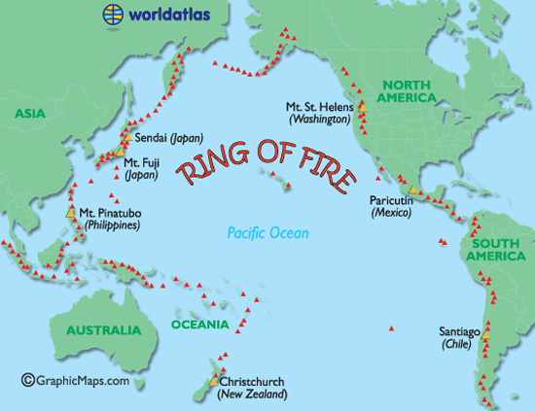
Most of the active volcanoes in the world are found around the Pacific Ocean.
http://www.worldatlas.com/aatlas/infopage/ringfire.htm

Slide 3
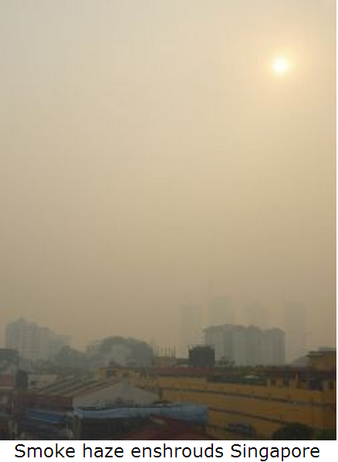

Slide 4
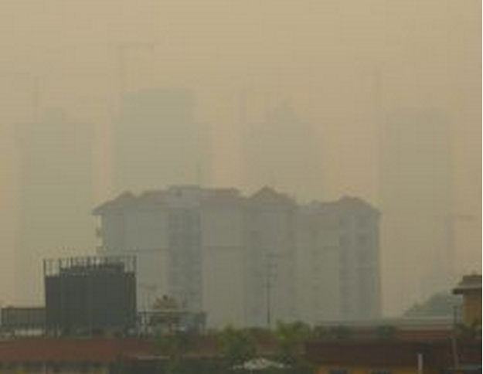

Slide 6
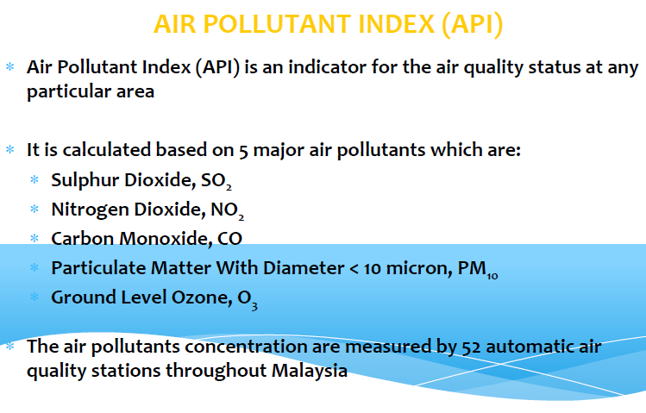

Slide 8
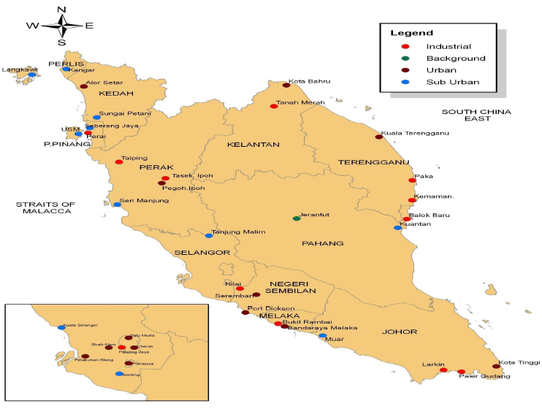

Slide 9
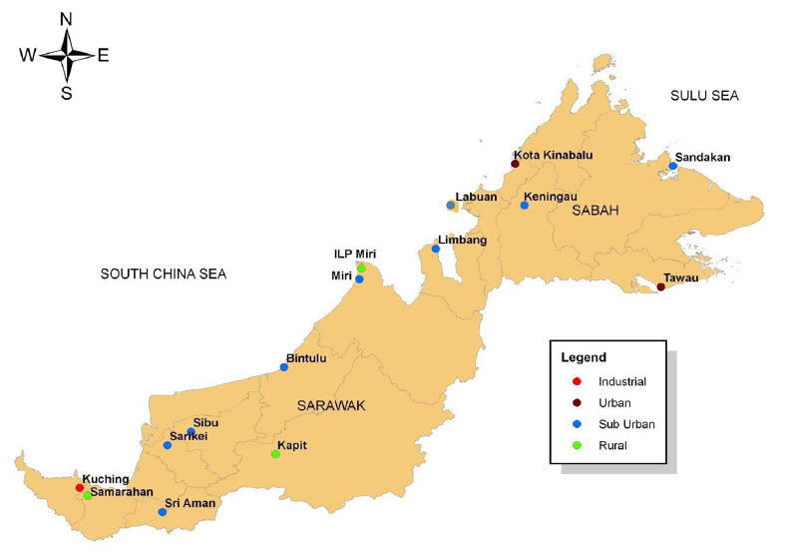

Slide 10
June to September each year, during the south west monsoon, much of Southeast Asia is hot and dry (unlike the northeast monsoon which brings wet weather).
the dry season was the time when farmers would use slash and burn techniques to clear rainforest to produce farming land.
Farmers still do that, even though it is now illegal.

Slide 11
Huge swathes of old growth rainforest are cleared each year for the monoculture palm oil plantations, causing immeasurable environmental harm, not only directly for the people affected by the toxic smoke haze, but also for the loss of biodiversity and increase in CO2 in the atmosphere.

Slide 12
PSI(Pollution Standards Index) a number representing the highest concentration of 5 common pollutants averaged over a 24-hour period.
Particulate matter (PM10, that is small particles with an "aerodynamic" diameter smaller than 10 µm);
Sulphur dioxide (SO₂);
Carbon monoxide (CO);
Ozone (O₃); and
Nitrogen dioxide (NO₂)

Slide 13
PM (particulate matter) affects more people than any other pollutant.
The major components
sulfate,
nitrates,
ammonia,
sodium chloride,
carbon,
mineral dust
water.
It consists of a complex mixture of solid and liquid particles of organic and inorganic substances suspended in the air.

Slide 15
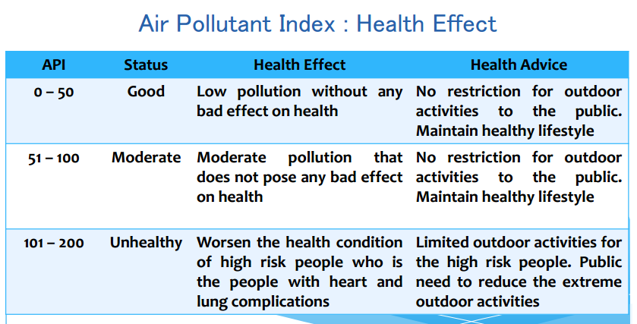

Slide 16
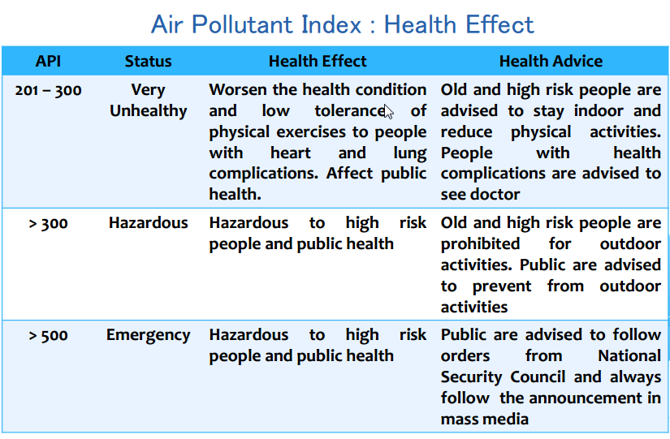

Slide 17
Key facts

Slide 18
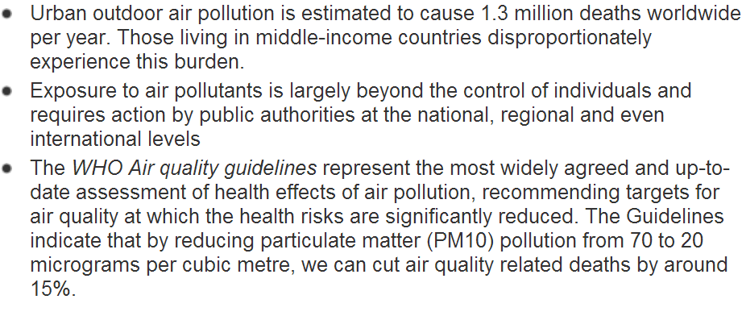
Key facts

Slide 19
How do we prepare ourselves?
Integrated in the school curriculum
Talks and visit
Fire drill
Fire extinguisher (expiry date)
Etc…

Slide 20
Where are we heading?

Slide 21
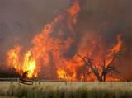
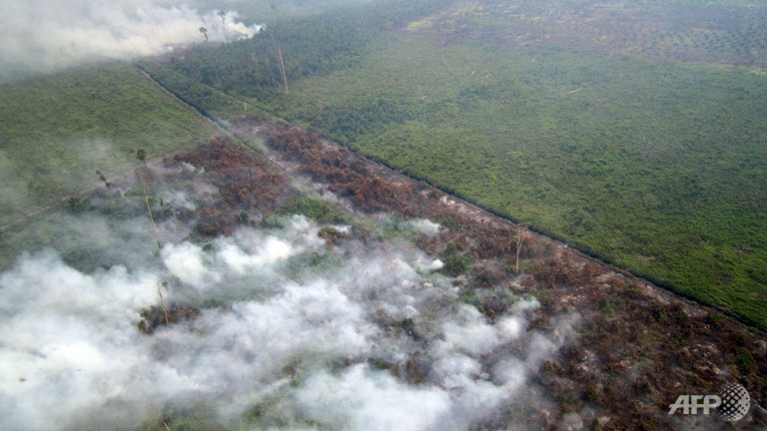
The exercise

Slide 22
In 2013, NASA’s Terra and Aqua satellites captured images of smoke from illegal wildfires on the Indonesian island of Sumatra blowing east toward southern Malaysia, causing thick clouds of haze in the region. As stated by a local Indonesian official, the source of the haze might be a 3,000 hectare peatland in Bengkalis Regency, Riau Province, which was set ablaze by an unknown party on 9 June. As many as 187 hotspots were picked up by satellites.

Slide 23
Visibility at several Malaysian airports was reduced by the haze, while the haze travels northwards to the northern Malaysian states of Terengganu, Kelantan and Penang. In Terengganu, visibility at the Sultan Mahmud Airport in Kuala Terengganu was reduced to 3 km in the evening, while that of Kerteh Airport was reduced to 6 km. In Penang, the Penang International Airport in Bayan Lepas also had visibility reduced to 6 km. Petaling Jaya and Subang, both in Selangor, were also hit by poor visibility at around noon, but it gradually improved to reach 6 km and 9 km respectively.

Slide 24
The Pollution Standard Index is really an attempt to provide a number that can be used for health advisories, such as the following:
PSI Value | Air Quality Descriptor
0 – 50 | Good
51 – 100 | Moderate
101 – 200 | Unhealthy
201 – 300 | Very unhealthy
Above 300 | Hazardous

Slide 25
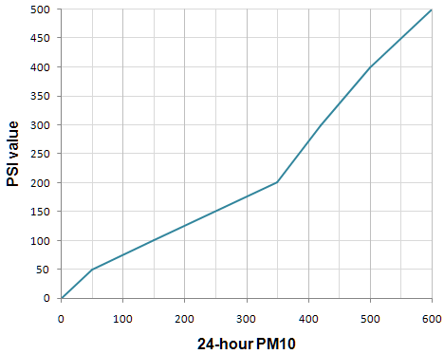

Slide 26
Questions
Consider the case where the 24-hour average of PM10 pollution is found to be 283 μg/m³,
What is the PSI value from the graph given?
Is the air quality healthy for people? Please explain your answer.

Slide 27
http://www.intmath.com/blog/math-of-air-pollution/8170
http://apims.doe.gov.my/apims/General%20Info%20of%20Air%20Pollutant%20Index.pdf
http://www.who.int/mediacentre/factsheets/fs313/en/

Slide 28
Lesson Study Planning
Team discussions:
Confirming the particular school
Study the syllabus
Finding the topic particular topic/subtopic to cover
Prepare the lessons
Run the lessons (March 2014)
Writing
Presentation (September 2014)

Slide 29
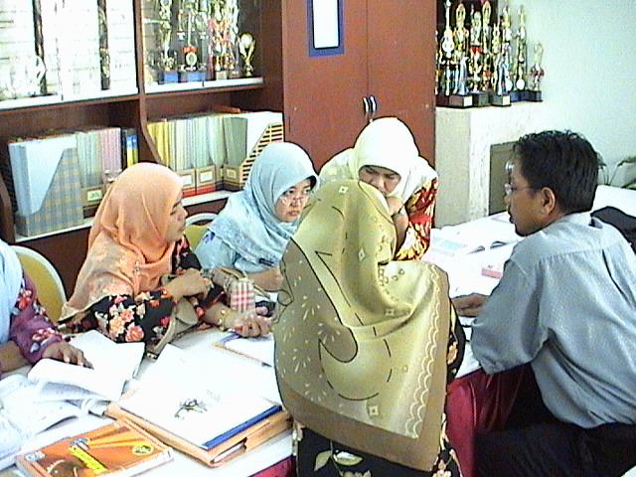
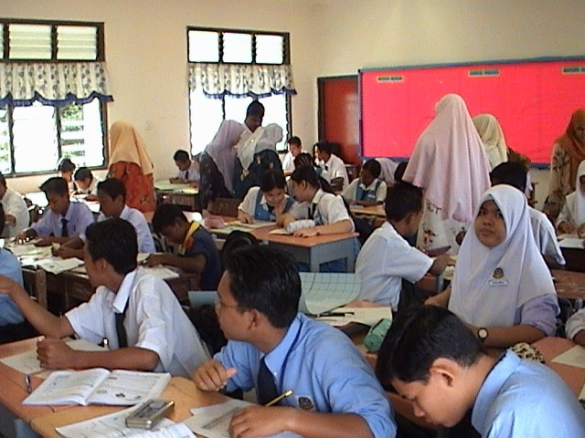
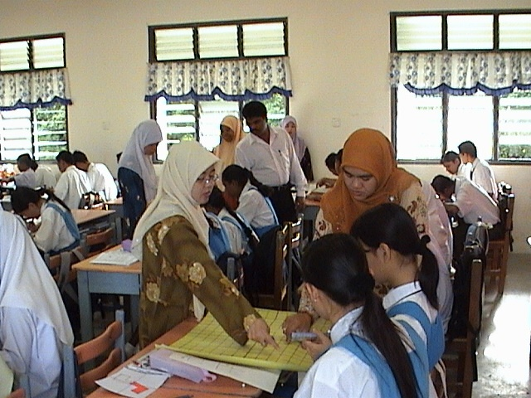
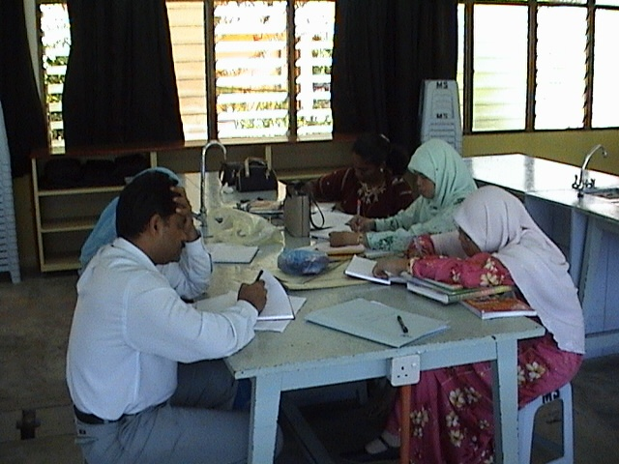
Lesson Study in Malaysia
Started with research done at Masters and PhD 2004

Slide 30
Perancangan dan Pembangunan Program Lesson Study
Program Komuniti Pembelajaran Profesional: Lesson Study atau lebih dikenali sebagai Professional Learning Communities: Lesson Study merupakan sebahagian daripada Program Pembangunan Prestasi Sekolah (School Improvement Programme) yang telah diamanahkan kepada Bahagian Pendidikan Guru (BPG), Kementerian Pelajaran Malaysia
PLC: Lesson Study melibatkan 289 buah sekolah yang terdiri daripada 274 buah sekolah menengah yang berada dalam band 6 dan 7 yang memperoleh GPMP 6.00 – 8.00 berdasarkan SPM 2009, bagi mata pelajaran Bahasa Inggeris, Sejarah, Matematik, dan Sains. Sementara itu, pemilihan 15 buah sekolah rendah dalam program ini pula adalah berdasarkan keputusan Ujian UPSR 2010 bagi mata pelajaran, Bahasa Inggeris dan Matematik dengan GPMP 3.00 – 4.00.

Slide 31
However most of the schools in the northern part of Malaysia are actively involve with lesson study
SEAMEO RECSAM and Malaysia Science University are in Penang
Dr Deva(RECSAM), Dr Cheah(RECSAM), Dr Lim Chap Sam(USM)

Slide 33
Thank you
Suhaidah Tahir
SEAMEO RECSAM
MALAYSIA
suhaidah@recsam.edu.my

